Slide 1
Building effective quizzes in CANVAS
Presented at UW-Superior’s Enhancement Day
January 16, 2020
Steve Baule & Stephanie Polkowski
Department of Education

Slide 2
Objectives
This presentation will walk participants through building a quiz in CANVAS. It will cover the various aspects:
setting a quiz up
determining how to set time and randomization parameters
provide for alternative “correct answers”
best practices in developing online quizzes
Notes:
What the participants will learn/take away
Participants should come prepared with quiz questions and/or an outline and will be taken through the steps of how to develop a quiz. Participants should be able to leave the session having created a usable quiz for an upcoming course. Participants will be able to set time limits, whether or not answers are shown during or after the quiz, how to limit or allow students to have multiple attempts, lock questions, set dates for availability of the quiz. Participants will then be able to explore the various types of questions available within the CANVAS quiz engine and how to establish question groups within the quiz which allow for randomization of a quiz.
What teaching/presentation methods you will use in the session (interactive sessions are encouraged)
This hands on session will lead participants through the process of developing a quiz within an existing course or course shell. Participants should be able to have a quiz completely developed if they bring a pre-generated set of questions with them to the session.

Slide 3
Quiz Basics

Slide 4
Before You Start
Be able to answer the following:
Graded v. Practice Quiz; Also could be a survey
Will it be added to an Assignment Group?
Do you want randomized questions? Randomized answers?
Time limit?
Multiple attempts?
Show students answers?
Require an access code or restrict IP address?

Slide 5
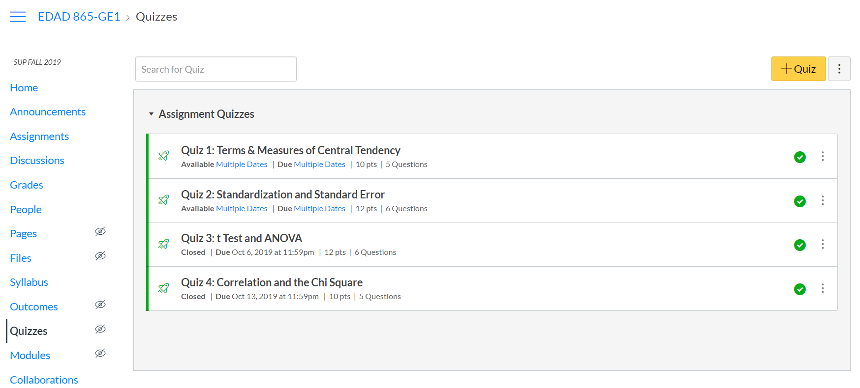

Slide 6
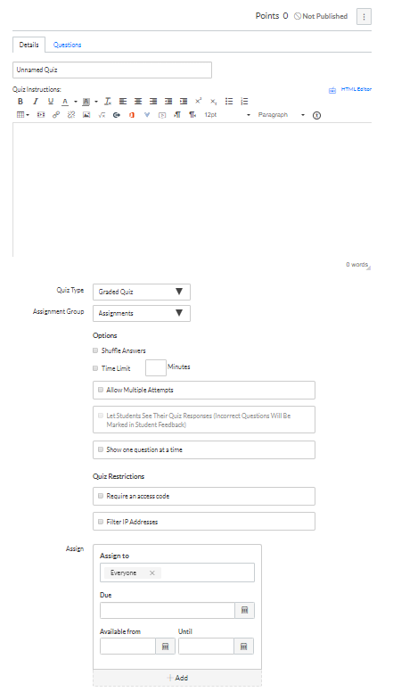

Slide 7
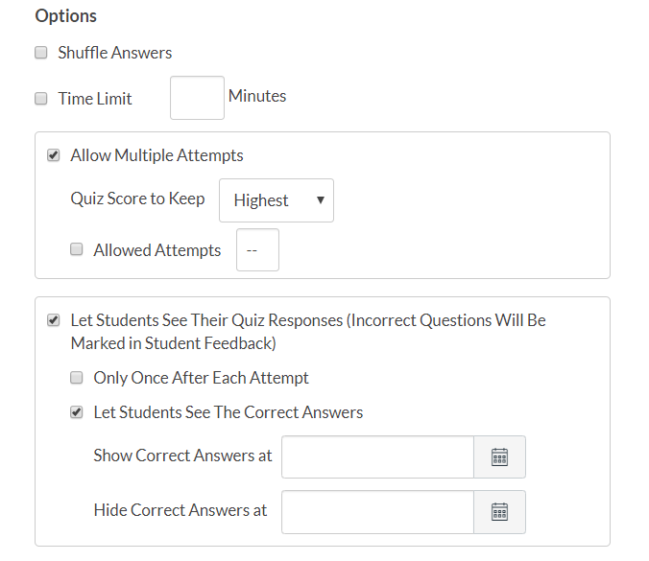

Slide 8
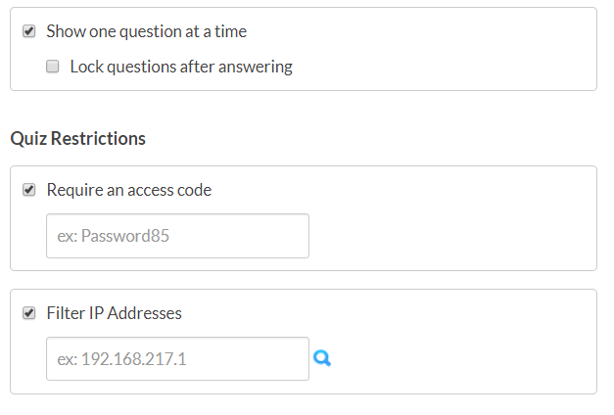
Securing the Quiz

Slide 9
Proctoring Tools
The Digital Strategies Team is working to pilot two proctoring tools:
Examity
Honorlock
If you are interested in participating in this limited pilot, please contact Michael Bartlett

Slide 10
Due Dates and Access

Slide 11
Adding Questions

Slide 12

Three Ways to add Questions
Individual Questions
Question Groups
Questions from a Question Bank

Slide 13
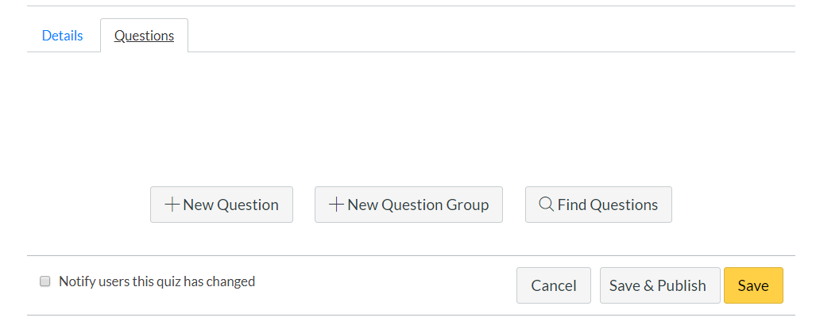

Slide 14
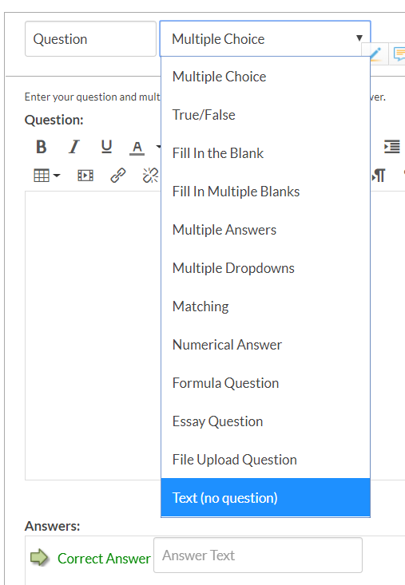
Question Types

Slide 15
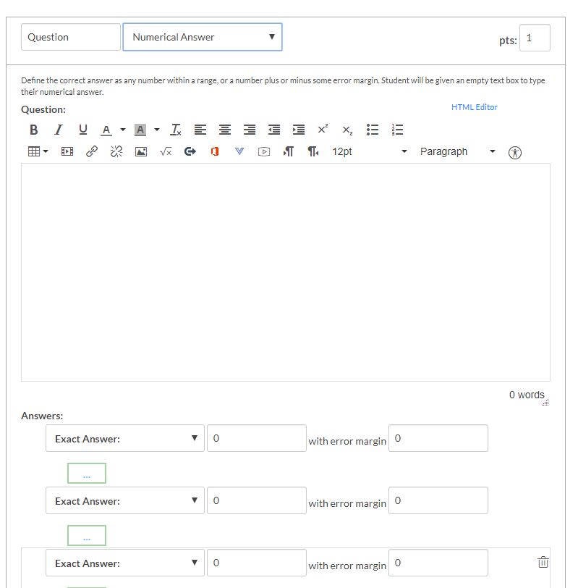
Answer fields change by question type

Slide 16
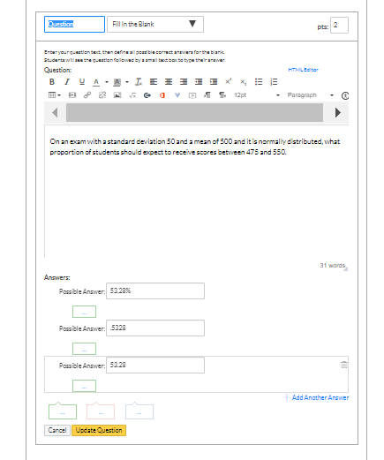

Slide 17
Question Group
Allows you to place individual questions within a group.
This allows you to select how many of the questions each student will receive

Slide 18
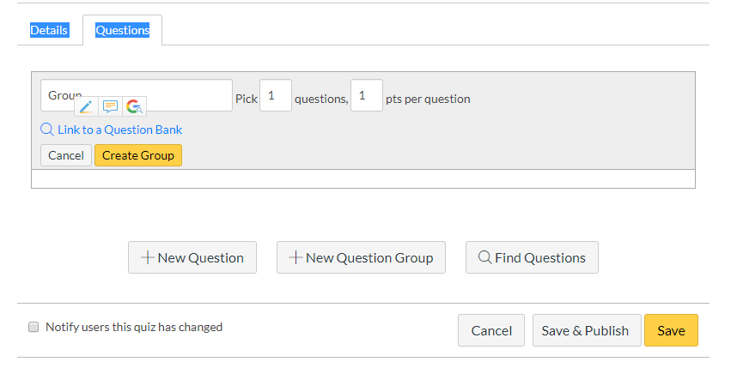

Slide 19
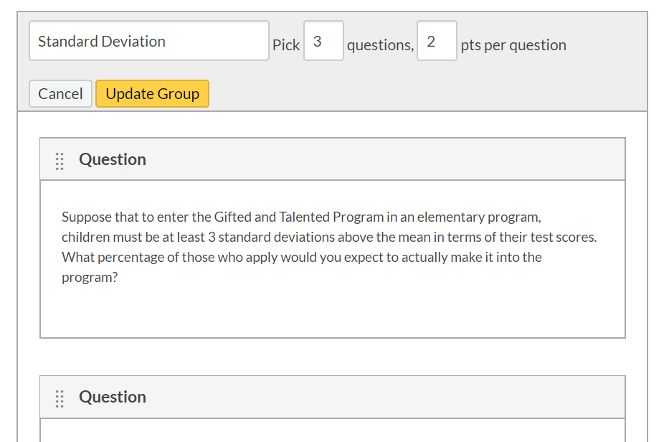

Slide 20
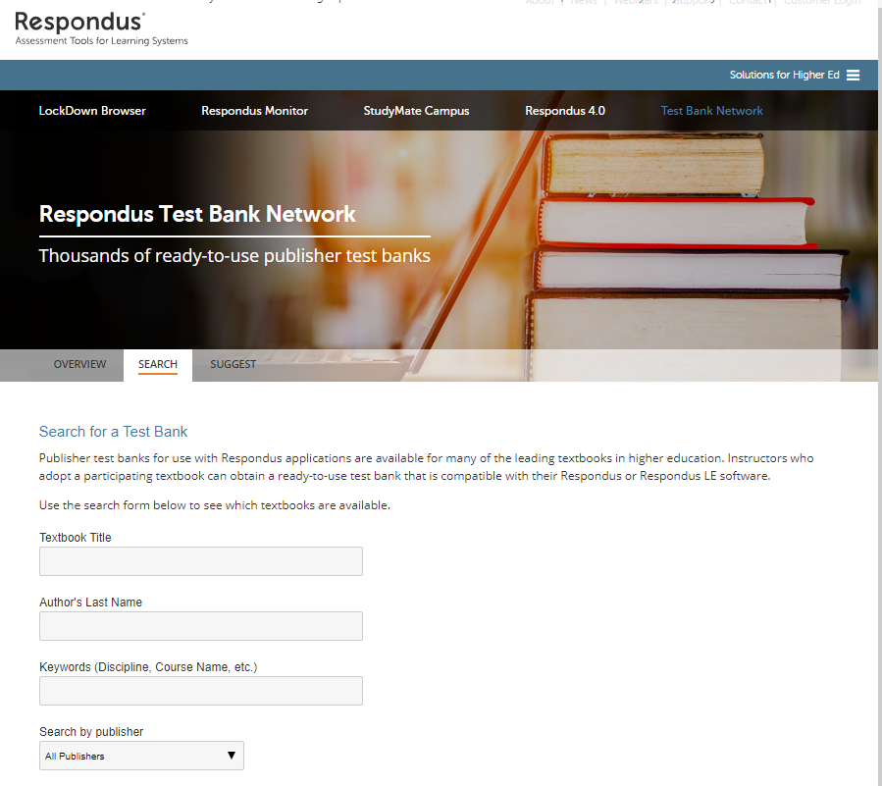

Slide 21
Some Cautions
Analytics are not available for quizzes over 100 questions
Analytics is available for up to 1000 attempts (for those with multiple attempts)
Some grade analysis requires at least five student responses

Slide 22
CANVAS Quiz Analytics

Slide 23
Student Analytics Report
A CSV file including all student answers identified as correct or incorrect
N correct for each student
N incorrect for each student
Total score for each student

Slide 24
Item Analysis Report
question ID
question title
answered student count
top student count (students in the top 27%)
middle student count (students in the middle 46%)
bottom student count (students in the bottom 27%)
quiz question count (total number of quiz questions)
correct student count (number of total students who got the answer right)
wrong student count (number of total students who got the answer wrong)

Slide 25
Item Analysis, cont.
correct student ratio (ratio of students who got the answer right)
wrong student ratio (ratio of students who got the answer wrong)
correct top student count (students in the top 27% who got the answer right)
correct middle student count (students in the middle 46% who got the answer right)
correct bottom student count (students in the bottom 27% who got the answer right)
variance (of scores on this question)
standard deviation (of scores on this question) difficulty index
alpha score (for the whole exam)
point biserial of the correct answer (reliability index)
point biserial of the first incorrect answer or distractor (followed by the second, etc.)

Slide 26
Resources
CANVAS. (2017, April 19). What options can I set in a quiz? Retrieved from https://community.canvaslms.com/docs/DOC-10152-415241475.
CANVAS. (2019, May 29). Quiz settings to maximize security. Retrieved from https://community.canvaslms.com/docs/DOC-3313-quiz-settings-to-maximize-security.
Glen Oaks Faculty. (2017, March 21). Building a quiz in CANVAS that decreases cheating. Retrieved from https://www.youtube.com/watch?v=KbX6kPNdEUg.
Gniffke, D. (2016, August 27). Canvas - how to use question banks with quizzes. Retrieved from https://www.youtube.com/watch?v=OIkrEtzC6P4.
Johnston, J. (2016, September 9). Creating a quiz in CANVAS. Retrieved from https://www.youtube.com/watch?v=pGKQCGuB3NI.
Kansas State. (2018). Designing better quizzes: Ideas for rethinking your quizzes. Madison, WI Magna Publications. Retrieved from https://www.k-state.edu/assessment/toolkit/measurement/Special-Report-designing-better-quizzes.pdf.

Slide 27
Resources
Lake Land College. (2019). Importing quiz questions into CANVAS. ISS Tutorials. Retrieved from https://lakeland.instructure.com/courses/1455362/pages/importing-quiz-questions-into-canvas.
Respondus: Assessment tools for learning systems. (2019). Retrieved from https://web.respondus.com/he/testbank/search/.
3A Ninjas. (2016, August 11). Importing testbanks into Canvas. Retrieved from https://www.youtube.com/watch?v=d_FaRlZU9gY.

Slide 28
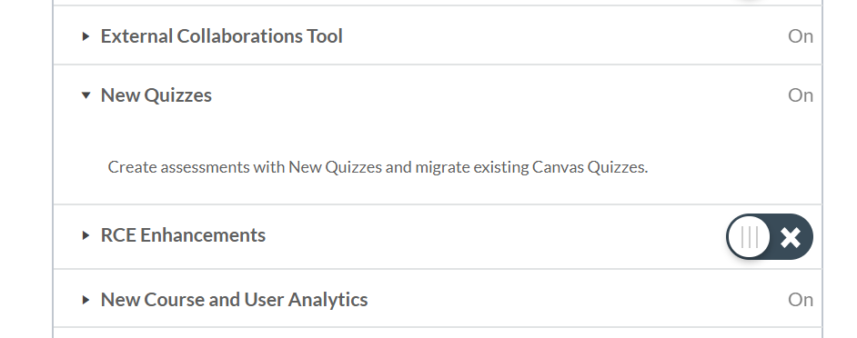
New Quizzes
Under SETTINGS select FEATURE OPTIONS
CANVAS. (2018). How do I migrate a CANVAS quiz to New Quizzes. Retrieved from https://community.canvaslms.com/docs/DOC-15077-4152837155
CANVAS. (2019). Canvas instructor guide. Retrieved from https://community.canvaslms.com/docs/DOC-10460-canvas-instructor-guide-table-of-contents#jive_content_id_New_Quizzes.

Slide 29
New Quiz Overview

Slide 30
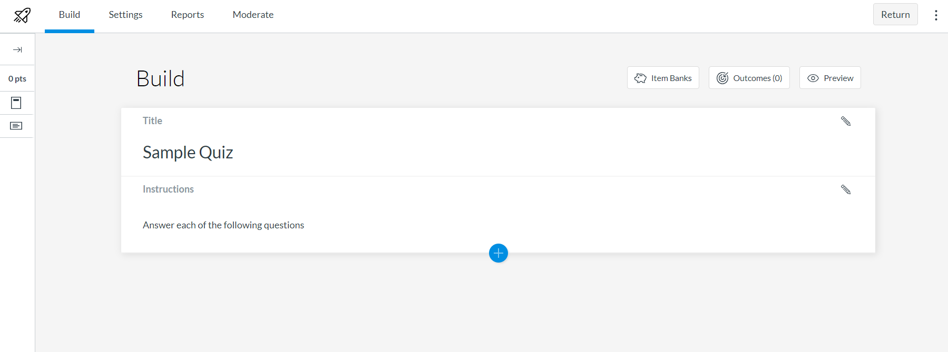
Opening Page for New Quiz

Slide 31
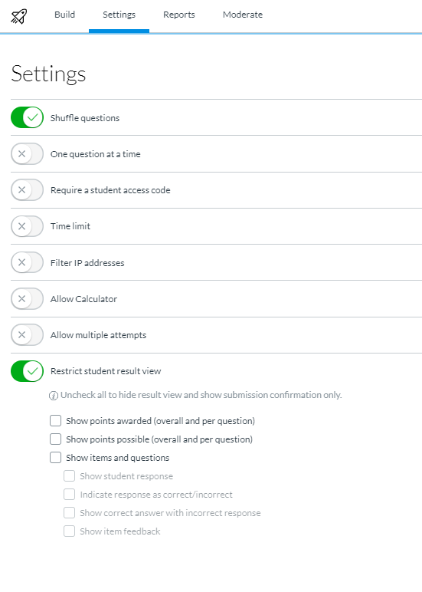
Settings

Slide 32
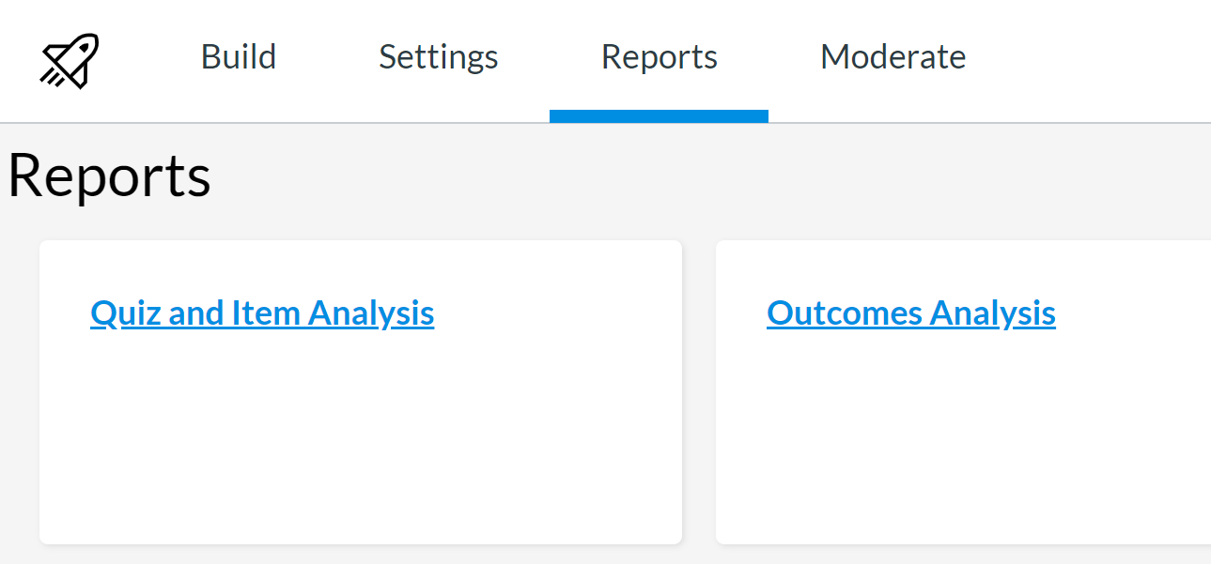
Reports

